Slide 1
Department of Political Science
SHUBHARAJ P. BUWA
ASSOCIATE PROFESSOR

Slide 2
HEARTY WELCOME
TO
THE NAAC PEER TEAM

Slide 3
Establishment of the Department
Department of Political Science established in 1984
Semester system adopted from 2011-12
Bachelor of Arts – Three years integrated degree course

Slide 4
Shubharaj P. Buwa, Associate Professor
Graduate from Shivaji University, Kolhapur
Post Graduation – Savitribai Phule Pune University
Cleared NET and SET examination
Teaching in this College since 1992

Slide 5
Refresher and Orientation courses
Sr. No. | Nature and name of the Course | Duration |  | Name of the University/Academic Staff College
 |  | From | To
1. | Orientation Course | 16/2/1999 | 19/3/1999 | ASC, Mumbai University, Mumbai
2. | Refresher Course | 26/2/2001 | 23/3/2001 | ASC, Jawaharlal Nehru University, New Delhi
3. | Refresher Course | 7/11/2005 | 28/11/2005 | ASC, Mumbai University, Mumbai
4. | Refresher Course | 28/11/2007 | 18/12/2007 | Mahatma Phule Adhyasan, University of Pune, Pune

Slide 6
Publications…
8 Chapters in 5 different Political Science Text Books
Edited one IDOL book
Translation of a Text book
One more book in the press…

Slide 7
University level work
Paper setter
Assessment
Moderation
Chairmanship of a Paper
Part of syllabus sub- committees
V. C. Nominee and Governing body nominee for selection and promotion interviews

Slide 8
Research
Ph. D. topic – Transformational Aspects of E-Governance – a case study of certain districts in Maharashtra
Guide – Professor Kannamma Raman, Department of Civics and Politics, University of Mumbai

Slide 9
Membership of professional organisations…
Maharashtra Political Science and Public Administration Conference
    (re-elected unanimously as a member of executive committee till 2019)
Indian Political Science Association
International Political Science Association

Slide 10
Participation in College activities
Chairman of
  Sports department
  Attendance committee
  Time Table committee
  Examination committee
  Discipline committee
  NSS Programme Officer for 7 years (2001-02 to 2007-08)
Member of
    Examination Committee
    Nishigandh Editorial Board

Slide 11
Software development…
MS Excel sheet for Salary and Form 16 of all employees.
From 2001 to 2010 – Result programme in MS Access.
NSS database.
Currently Online result declaration module in PHP + MySQL + HTML + CSS
  Useful for students as well as office staff.

Slide 12
6 Semesters and 12 Papers
Semester no. | Paper no. | Paper title | Internal marks/Passing marks | Semester end exam. Marks/Passing marks
1 | 1 | Indian Political System – The Constitution | --- | 100/40
2 | 1 | Indian Political System – The Political Process | --- | 100/40
3 | 2 | Indian Political System – The Constitution | 25/10 | 75/30
3 | 3 | Public Administration | 25/10 | 75/30
4 | 2 | Indian Political System – The Political Process | 25/10 | 75/30
4 | 3 | Indian Administration | 25/10 | 75/30
5 | 4 | Politics of Modern Maharashtra | 25/10 | 75/30
5 | 5 | Western Political Thought | 25/10 | 75/30
5 | 6 | World Politics | 25/10 | 75/30
6 | 4 | Determinants of Politics of Maharashtra | 25/10 | 75/30
6 | 5 | Indian Political Thought | 25/10 | 75/30
6 | 6 | India in World Politics | 25/10 | 75/30

Slide 13
Bachelor of Arts…
One division
Medium of Instruction - English + Marathi
Most of them offer Marathi medium
Choice of subjects available at third year.

Slide 14
Student strength
Year | FYBA | SYBA | TYBA | TYBA POLITICAL SCIENCE
2011-12 | 120 | 82 | 90 | 90
2012-13 | 118 | 82 | 93 | 90
2013-14 | 120 | 66 | 63 | 52
2014-15 | 133 | 73 | 53 | 51
2015-16 | 130 | 48 | 64 | 52
2016-17 | 132 | 24 | 31 | 31

Slide 16
Efforts to enrich learning experience
Online Quizzes Visit to US consulate Guest Lectures
WhatsApp group Audio Visual Moodle Site

Slide 17
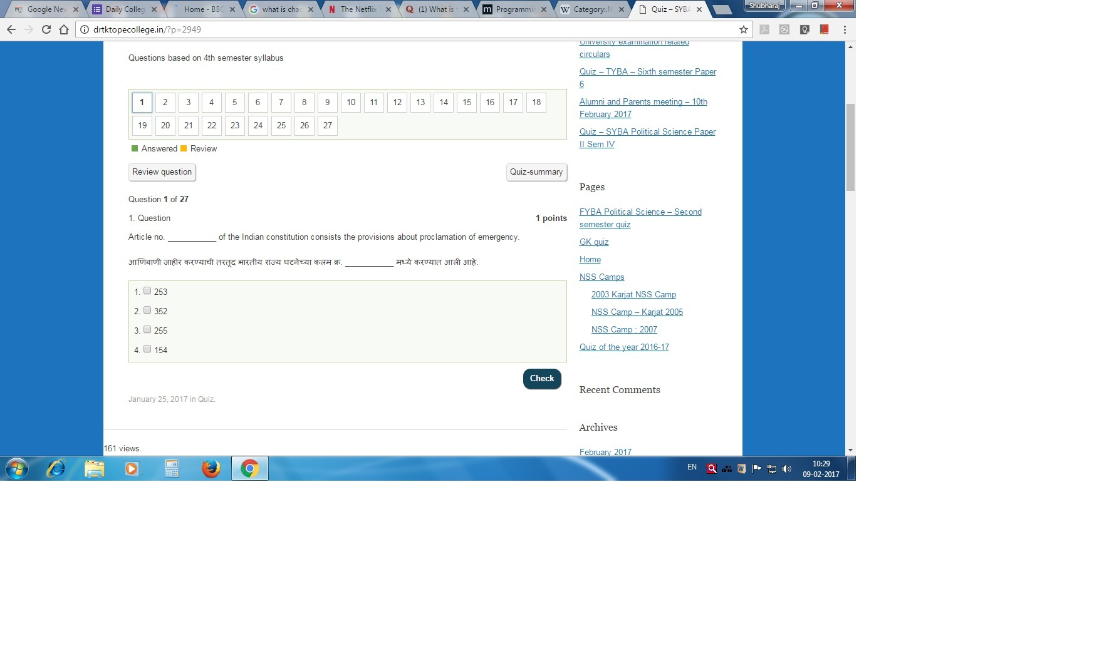
Quiz for SYBA - Screen Shot

Slide 18
Guest Lectures and Visits
Sr no. | Date | Guest | Topic
1 | 7 FEBRUARY 2016 | Virendra Valsangkar | Making Documentaries
2 | 23 FEBRUARY 2016 | Dr. Swati Pitale | Nationalism of Ravindranath Tagore
3 | 24 FEBRUARY 2016 | Prof. Dr. Sanjay Deshpande | India – Russia Relations
4 | 25 FEBRUARY 2016 | Prashant Kelkar (Associate Professor) | The Kashmir Issue from a different perspective
5 | 20 MARCH 2016 | Visit to US consulate | Lecture on India – US relations
6 | 30 AUGUST2016 | Dr. Chaitra Redkar | Simon de Beauvoir

Slide 19
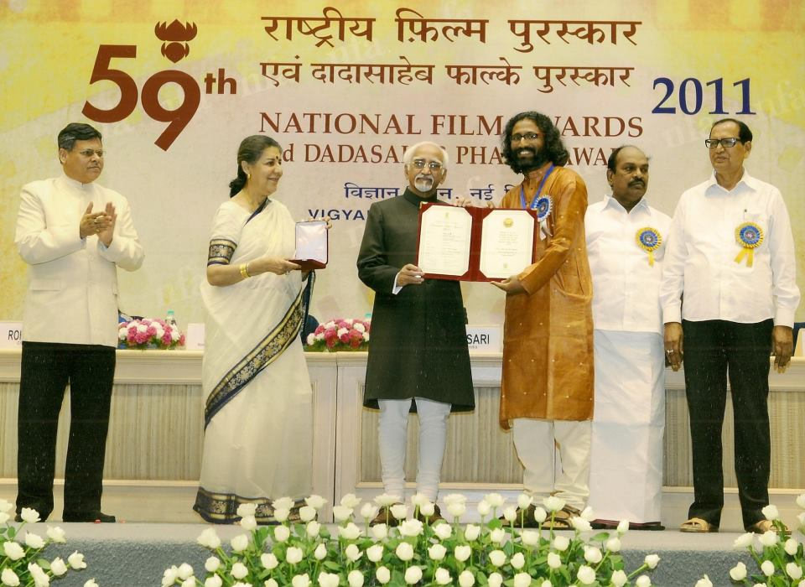
Virendra Valsangkar – National Film Award

Slide 20
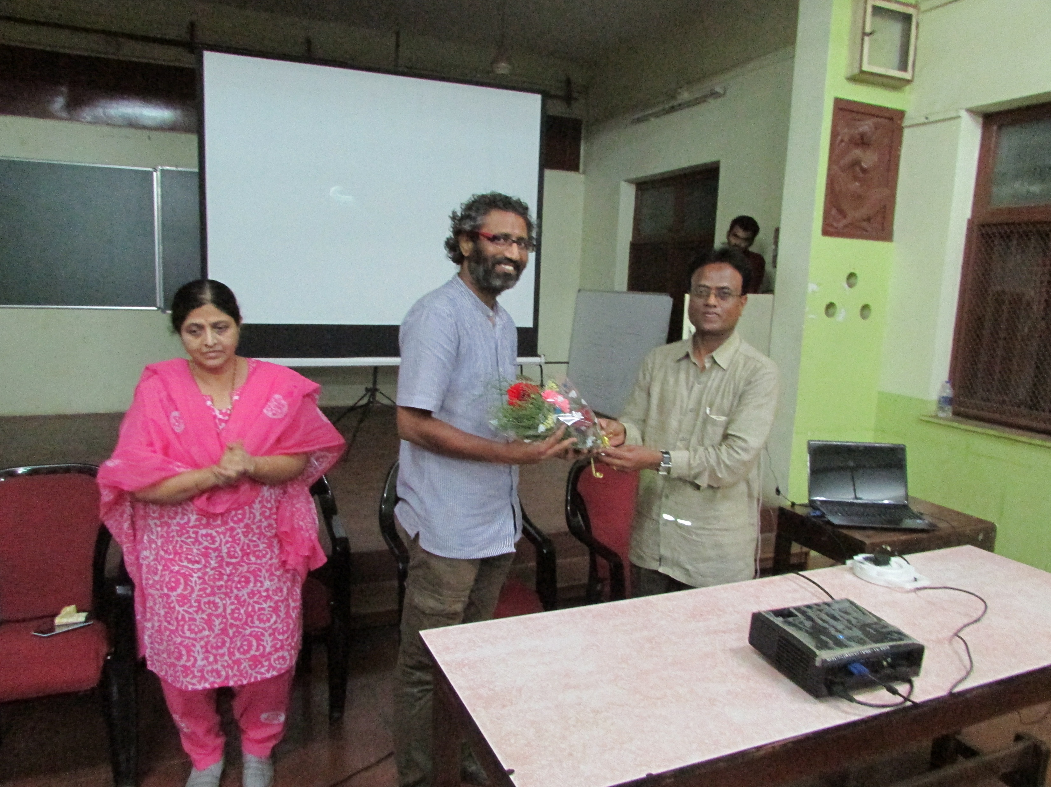
Virendra Valsangkar – Making Documentaries

Slide 21
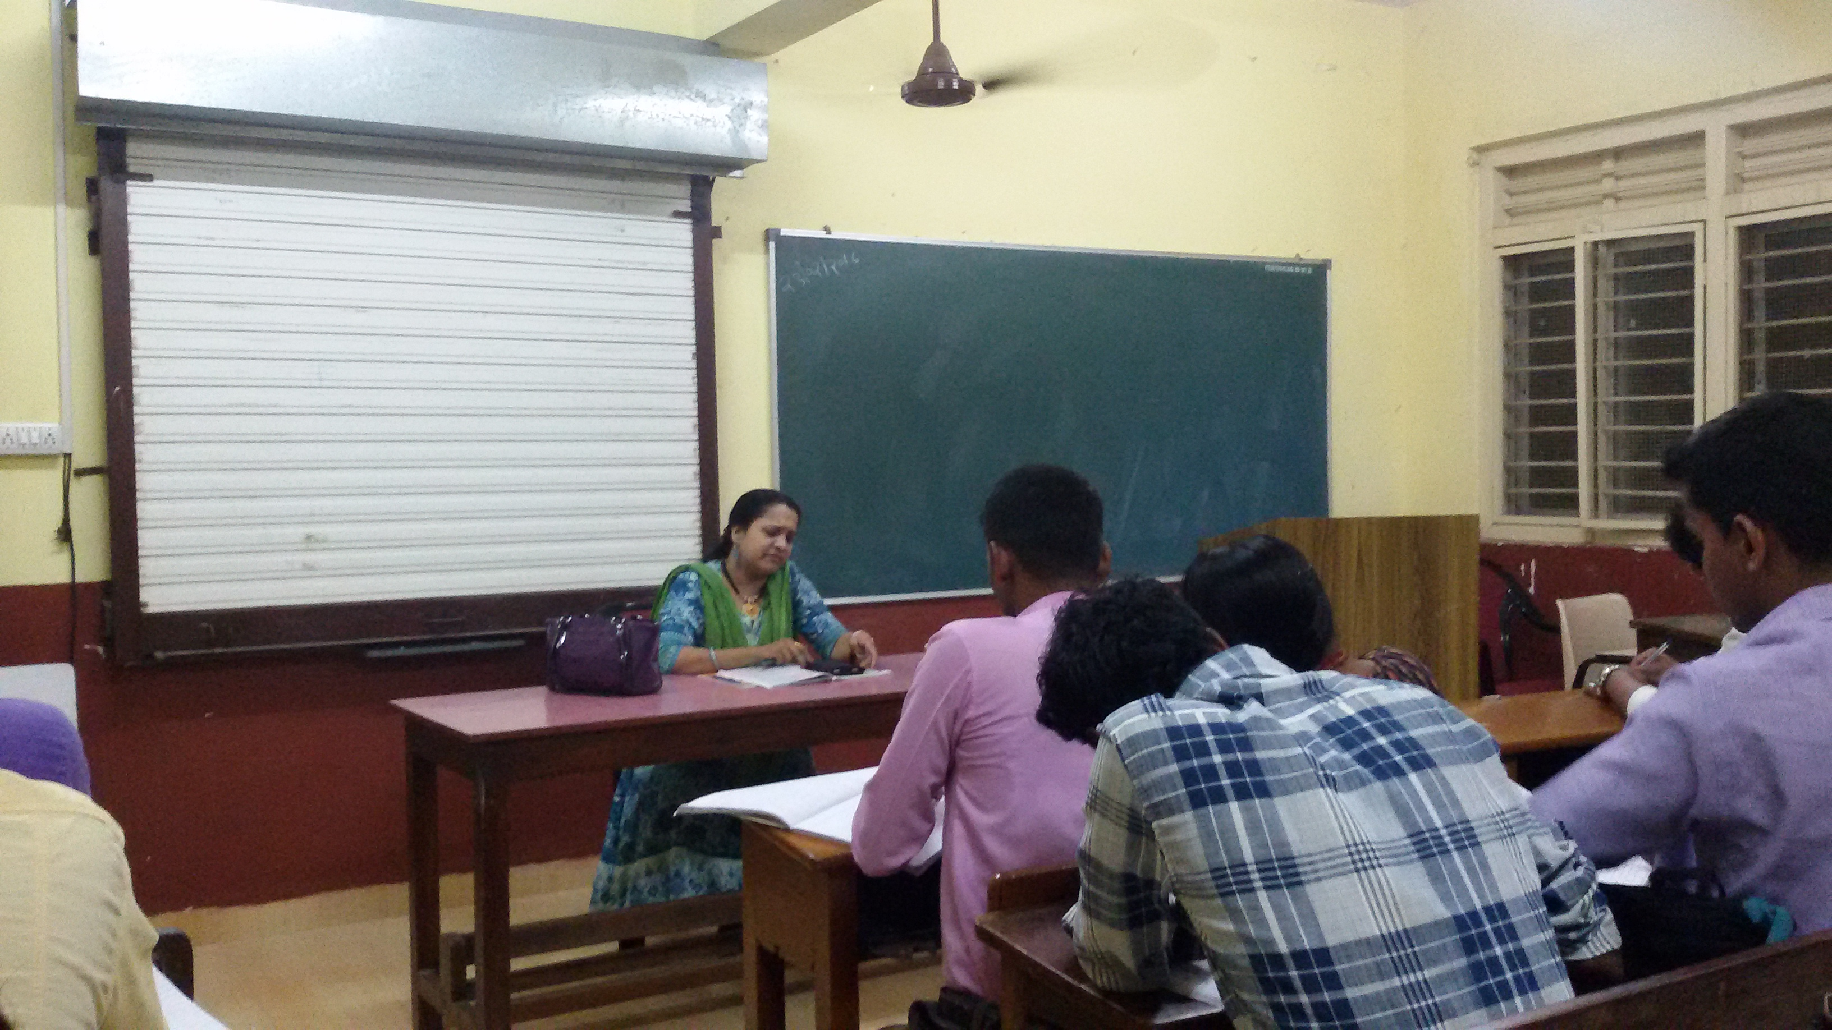
Dr. Swati Pitale - Nationalism of Ravindranath Tagore
23-2-2016

Slide 22
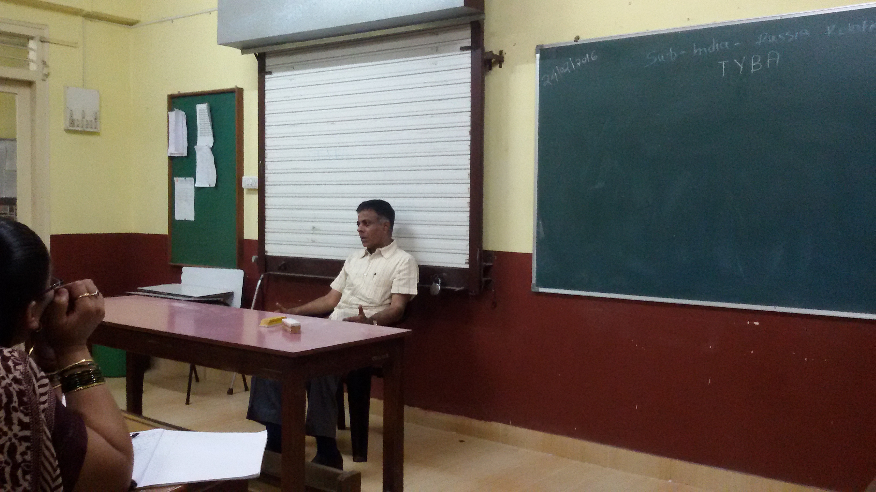
Dr. Sanjay Deshpande – India Russia Relations

Slide 23
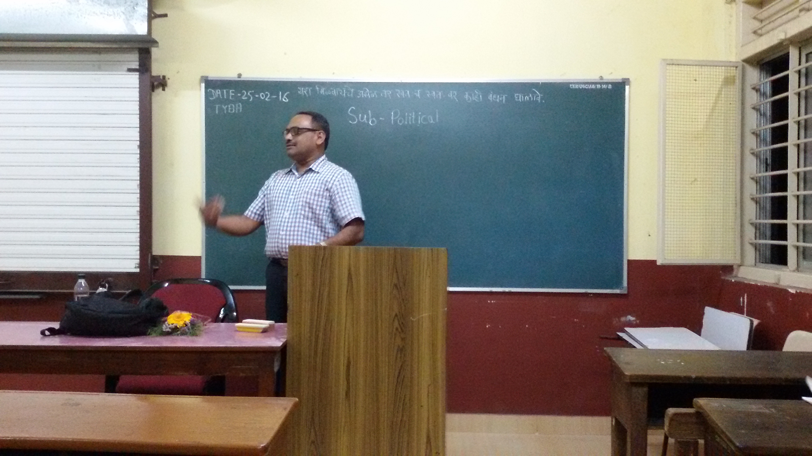
Prashant Kelkar – Kashmir Issue – a different perspective

Slide 24
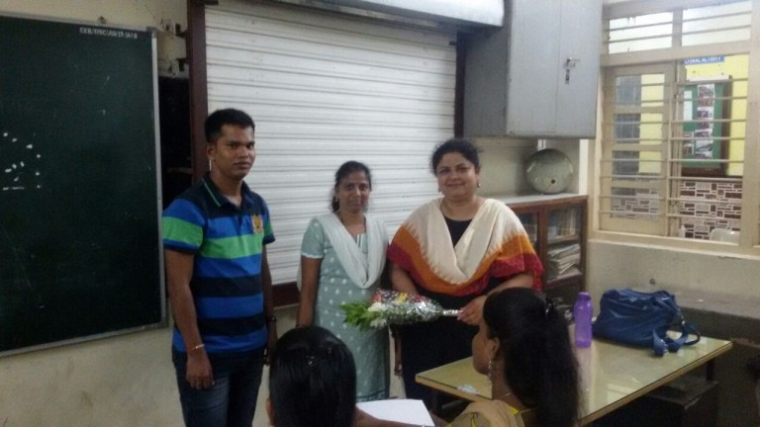
Dr. Chitra Redkar from SNDT University on Simon de Beauvoir 30-8-2016

Slide 25
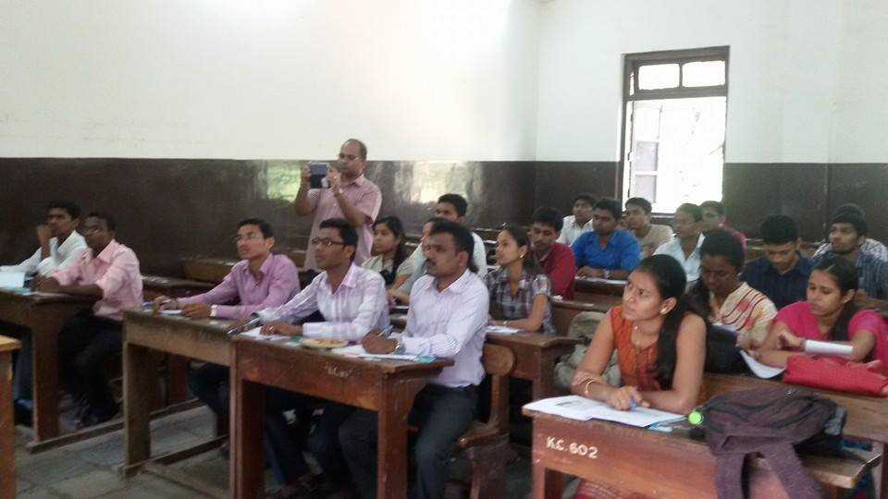
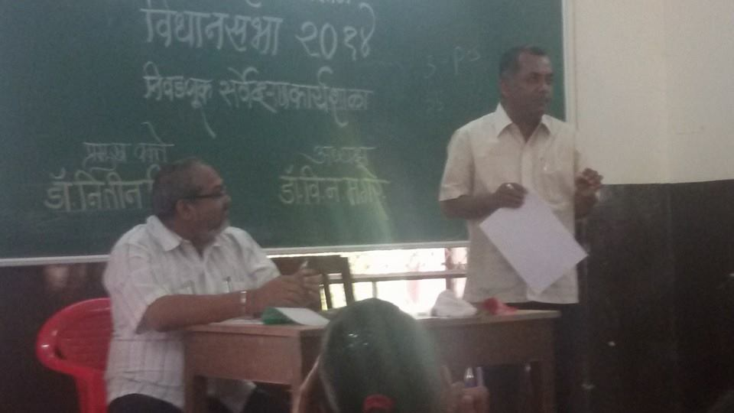
Students participated in the Election workshop organised by Savitribai Phule Pune University, Pune at Kirti College and the actual survey.

Slide 26
THANK YOU

