Slide 1
Constitution Day – 26th November 2016
Fundamental Duties
A Presentation by Shubharaj Buwa
Associate Professor, Political Science

Slide 2
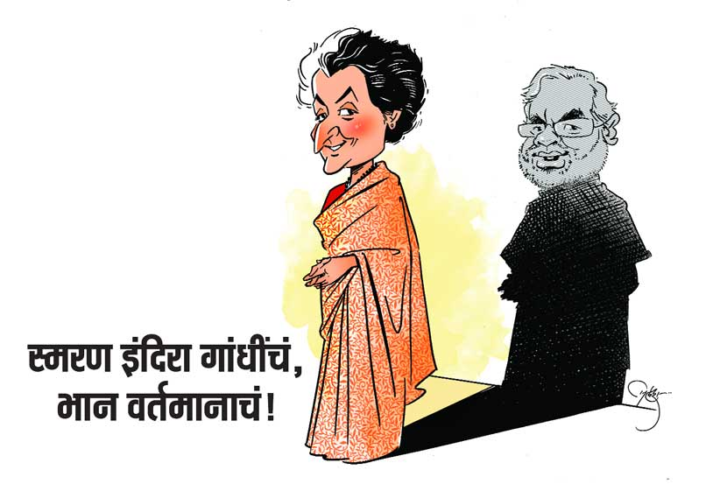

Slide 3
Prime Minister Modi’s style of functioning
परराष्ट्र धोरणावरचा भर, नेहरू जाकिटाप्रमाणे मोदी कुर्ता आणि जाकिटे लोकप्रिय होणं, नेहरूंप्रमाणे चिंतनशील संवाद साधण्याचे प्रयत्न.
नेहरू ही त्यांच्या राजकारणाची महत्त्वाकांक्षा आहे; पण इंदिरा गांधी हा त्यांच्या राजकारणाचा स्वभाव आहे असं म्हणायला खूपच वाव आहे.
  डॉ. सुहास पळशीकर

Slide 4
11 Fundamental duties
10 Fundamental duties
Part III - Article 51 A of the Indian Constitution
42nd amendment, 1976
11th added by 86th amendment act 2002 – w.e.f. 1-4-2010

Slide 5
Influence of Other Constitutions
Constitutions of the following countries mention fundamental duties :-
  Japan
  Netherlands
  USSR (The constitution of Russian Federation also mentions obligations of citizens.)

Slide 6
Basic Information

Slide 7
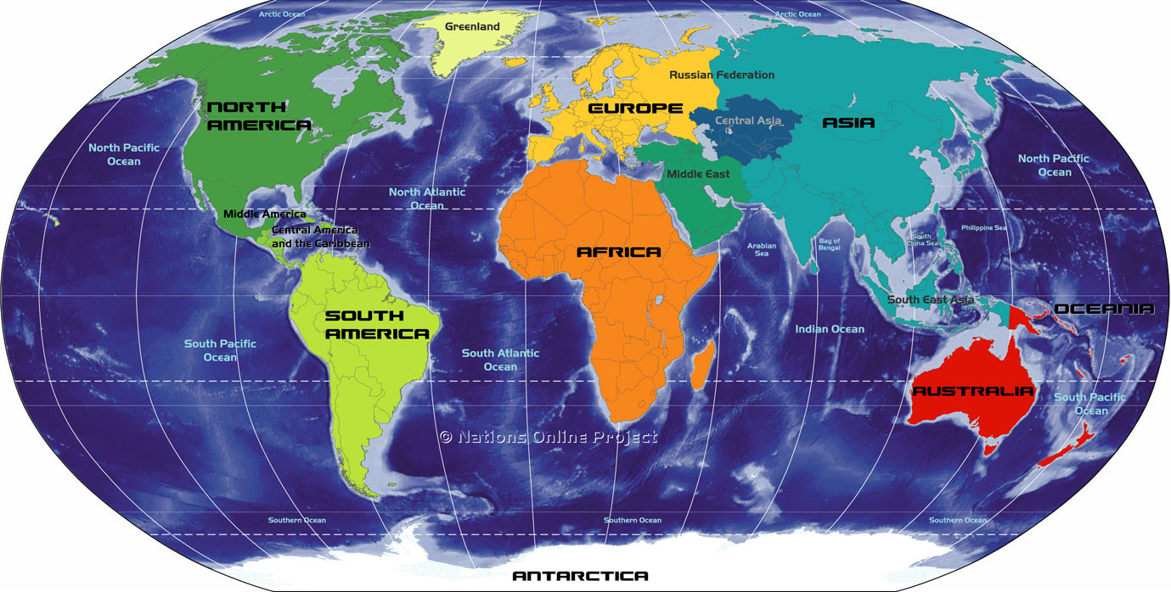
Six Continents

Slide 8
196 Sovereign Nations

Slide 9
All 196 nations have a Constitution

Slide 10
Constitution is the basic law of the country.
It provides the basic framework to make laws.

Slide 11
Example
Art. No. 19 – 22 - Right to Liberty – Fundamental Right
Exception – Government can restrict it under some conditions.
The ill-famous TADA and NSA are the laws made by the Parliament on this basis.

Slide 12
Example 2
Article 17 – “…Untouchability shall be an offence punishable in accordance with law.”
Many acts made by the Parliament and the state legislatures on this basis.
The laws provide definitions of concepts such as ‘untouchability’, ‘downtrodden castes’ etc.

Slide 13
TYPES OF CONSTITUTIONS
Written - Almost all nations have a codified constitution.
Except UK, Canada, Israel, New Zealand, Saudi Arabia
they have an
Unwritten (uncodified) constitution

Slide 14
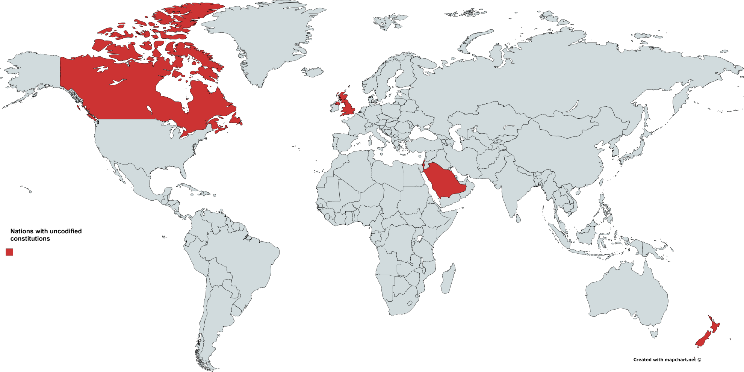
Uncodified Constitutions

Slide 15
Main features of Indian Constitution
Longest written constitution - 395 articles, 12 schedules, 101 amendments.
Written by an indirectly elected constituent assembly.
Task was completed in 2 yrs. 11 months and 18 days. (9th Dec. 1946 to 26th Nov. 1949)

Slide 16
Features…2
Chairman of the Constituent Assembly – Dr. Rajendra Prasad.
Chairman of the Drafting Committee – Dr. Babasaheb Ambedkar.
Architect of the Constitution.

Slide 17
Features…3
Parliamentary Democracy
Secularism
Federalism
Single citizenship
Adult franchise
Fundamental Rights
Directive Principles
Partly rigid and mostly flexible

Slide 18
Constitutional Amendment
Change is permanent.
Constitutions written by fallible human beings.
Therefore amendment necessary.

Slide 19
History of amendments
101 amendments
First Amendment – 1951

Slide 20
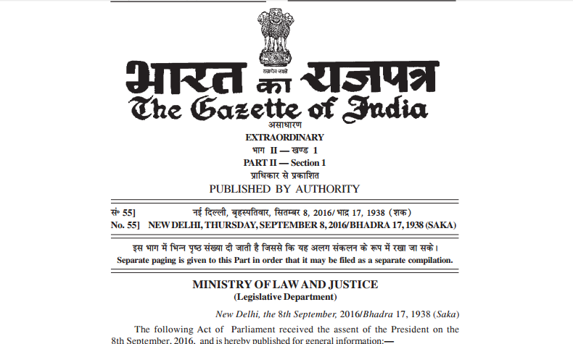
101st amendment – Sep. 2016

Slide 21
History…
Nehru era – 1950 to 1964.
Lalbahadur Shastri – 1964 to 1966.
Indira Gandhi – 1966 to 1977 and 1980 to 1984.

Slide 22
Types of Emergencies (352 – 360)
National, Financial and State emergency (Presidential rule in a state)
National emergency - 1962, 1971, 1975
No experience of Financial emergency
Presidential rule imposed in several states, several times.

Slide 23
National Emergency 1975
Imposed due to internal disturbances.
High handed behaviour of the government.
Threatening atmosphere.
Swarn Singh Committee and its suggestions.

Slide 24
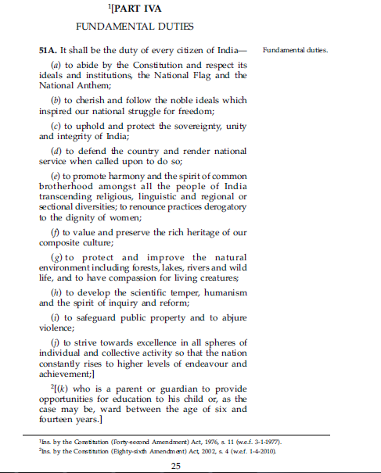

Slide 25
Respect
  Constitution
  National Flag
  National Anthem
Cherish and Follow
  Noble ideals of freedom struggle

Slide 26
Protect
  Sovereignty
  Unity
  Integrity Of India

Slide 27
To defend the country
Render national service

Slide 28
Harmony
Brotherhood
Dignity of women

Slide 29
Preservation of rich heritage of our composite culture.

Slide 30
Protection of natural environment.
Compassion for all living creatures.
Develop
  Scientific temper
  Humanism
  Spirit of inquiry and reform

Slide 31
Safeguarding public property.
Renounce violence.
Strive towards excellence.

Slide 32
Finally…
It is the duty of the parents to provide primary education to children between the age of six and fourteen years.

Slide 33
Constitution Day – 26th November 2016
A presentation by Shubharaj Buwa
  Associate Professor, Political Science
  Presentation available at - http://drtktopecollege.in/?p=2838
  Contact information:-
    shubharaj.buwa@gmail.com
    https://www.facebook.com/shubharaj
    Website
    http://drtktopecollege.in/pol/

